Slide 1
















www.insb.gr
International Naval Surveys Bureau
Greek Ship Classiﬁcation Society
Building trust.
Shaping Safety
Newbuilding supervision | Ship Classification Statutory Surveys & Certification
Engineering appraisals ISM/ISPS Codes & MLC, 2006
INSB Class

Slide 2




















mission
Safety for life and property at sea, quality, sustainability and immense responsibility for environmental protection compose the foundation of our corporate mission.
13
Authorizations
5
What we do
14
Management Systems
INSB’s loyalty to operational safety is eminent as we work to identify & manage potential risks to achieve improved ship safety and compliance throughout vessels demanding lifecycle.
8
Class Entry
19
Yachting
We are conscious for operationally sound vessels that perform best in an uninterrupted manner.
9
New Building
20
Locations
Thus, we strive for vessels continued technical integrity and fleet optimization by means of regular ship survey program and technical assessments.
11
Classification Features
2
NSB Class

Slide 3


About INSB
International Naval Surveys Bureau S.A (or simply known as INSB Class ) is a
Greek ship classification society, headquartered in Piraeus, Greece, with almost four decades of continued presence in the international marine industry.
Aconducts safety surveys for ships
INSB Class surveying and certification services rendered via an extended international network of exclusive offices and surveyors, are to ensure that irrespective to fleet configuration, applicable safety standards are met and maintained in line with internationally recognized safety standards and general EU criteria.
s an independent technical
supervisory organization, INSB Class
classification, statutory and management systems certification together with the applicable verification appraisals & engineering approvals.
INSB@a glance
Industry Area served Key ﬂeet
Marine -Naval Architecture Worldwide
General cargo, Bulk carriers, Tankers, Containers, Multipurpose, Yachts, RO ROs, etc.
Type Founded Genre
Independent third party 1977
Ship Classiﬁcation Society ( Greek Organization)
NSB Class
3

Slide 4











INSB experts and staff have shared values for uncompromising quality, sustainable growth and factual result orientation.
Our approach
As a reputable organization INSB Class Society is dedicated to conducting all of its operations in a safe, responsible, impartial and ethical way, thus being regarded as a highly reliable, competent and trustworthy provider within the maritime industry.
T
he professional practices and activities of INSB Class:.
INSB Class business deliverables and technical services satisfy internationally recognized safety and quality standards, IMO Conventions, Flag States national requirements and general EU criteria.
are delivered in good faith, honesty and fairness;
apply our adopted corporate policies and procedures;
are based on defined standards and internationally accepted criteria;
are rendered from a transparent, objective and independent stand point.
Evidence of how the applied INSB Class services aim to achieve and retain ship’s technical integrity and fleet optimization.
4
NSB Class

Slide 5


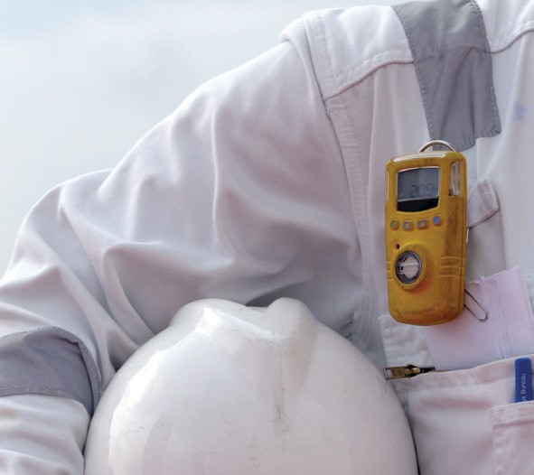




What we do
INSB Class services offered are to ensure that irrespective to your fleet configuration or trading pattern, applicable safety, operational & environmental standards are met and maintained.
e
Ship Classiﬁcation
l
Governmental Services
j
Management Systems
INSB ship classification related services include new building supervision on site, survey
of fleet in service, as well as applicable plans and studies approval.
INSB Class has been delegated by an extended number of
Flag Administrations to act on their behalf for the conduct
of statutory surveys and certification.
INSB services aim to identify and manage potential risks to achieve safety and regulatory compliancy through out vessels operating lifecycle.
INSB classification scheme and ship care system is to ensure that your vessels continue
to maintain compliance with international safety regulations and meet challenging certification demands, worldwide.
INSB surveying and certification activities are directly relevant
to the major international conventions and codes, as well as with national requirements pertaining to ship safety and for the prevention of marine pollution.
Our systems certification portfolio includes assessment and verification services across a wide range of management systems as per the ISM and ISPS Codes as well as under the MLC, 2006 requirements.
NSB Class
5

Slide 6





Survey & Beyond
INSB Class belongs to the leading Non IACS ship classification societies and is well regarded as a highly competent and trustworthy provider within the maritime industry.
Classification Surveys are based on a regular five-year cycle including Annual Surveys, an
Intermediate Survey and a comprehensive Special Survey including dry docking or underwater inspection in lieu of dry docking twice in a five year period.
INSB surveyors also attend repairs and /
or modifications to determine that the work performed returns the unit to a condition that conforms to the INSB Rules.
INSBset of Rules & Regulations,
Services rendered by INSB Class include:
society has developed its own
relevant to ships design, construction and operational maintenance, in line with IACS unified requirements.
Ship classification scheme including periodic surveys for maintenance of class.
Surveys & supervision on site for ships during construction.
Engineering studies , plan approval & technical review & calculations services
Statutory surveys & certification.
ISM & ISPS systems assessment & certification.
MLC 2006 assessments and verifications.
Technical interpretation and consultancy services.
Surveys of Damage , Modification or repairs.
Design and Construction requirements, the scope of tests and surveys are defined by the Rules
for Ship Classification and Construction. INSB Class confirms a ship’s compliance with these requirements by issuing a Certificate of Ship’s Classification and by entering into the society’s Register of Ships.
INSB Class rules require that every classed vessel shall be subject to periodic surveys throughout its service life to determine whether it is maintained in accordance with classification standards.
6
NSB Class

Slide 7
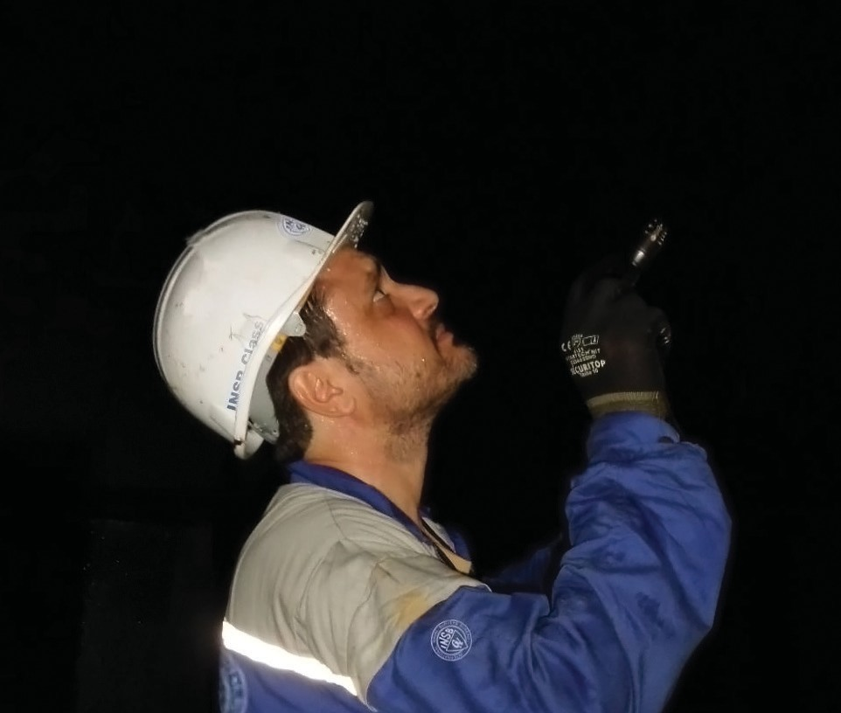



Everyone has a past.
ours is almost 4 decades of growing marine knowledge and technical experience.
NSB Class
7

Slide 8












Z
Making the right choice
INSB Class admission can be customised to fleet configuration and operational requirements via five year survey programs.
Class Entry
Admission to INSB Class is smooth yet standards compliant process and can be enacted by contacting either the INSB Head Office or your local INSB field station.
Isurveys requirements, the following information
Main class plans, manuals and booklets, as deemed necessary by INSB Class for vessel’s type, class notation and type of service
Copy of vessel’s Flag Registry Certificate
Copies of exemption certificates, if any
n order to commence the class admission
process and to determine the applicable entry
and documentation of the vessel should be transmitted to INSB Class:
Vessel’s Existing Classification Certificate and its Annexes
Latest survey status report including memoranda, conditions of class or posed recommendations, if any
The list of continuous machinery survey items (when applicable)
Copies of standing Statutory certificates
A program of surveys will be then set forth based on the outcome of the first document review results plus ship’s existing periodical cycle of surveys of the loosing society.
A prompt schedule for vessel’s attendance shall be determined in contact with ship operators to ensure minimal disruption to vessel’s trading activity.
8
NSB Class

Slide 9


New Buildings
INSB Class has supervised the construction of an expanding number of vessels of various types and sizes (all stages) and which have been satisfactorily and timely delivered.
In a new building project, INSB Class proceeds to:
ô @ A
,
ó
?
Review of class-relevant design documentation, calculations and drawings
Witnessing of functional tests, including dock and sea trials
Design approval, survey, certification of materials and equipment
initial Class survey for the issue of ship’s H/M & Equipment certificate
Supervision of the vessel’s construction on site
initial Statutory surveys for compliance certification on behalf of intended Flag State
NSB Class
9

Slide 10





L
INSB Class performs drawings reviews, approvals and engineering studies, necessitated for accepting and maintaining vessels in its classed register
h
Surveys of maintenance of Class
3
Assignment of class, classification characters and notations
10
NSB Class

Slide 11




Classiﬁcation Features
❶ Ship related appraisals
Review and approval of Ship’s constructional plans
Design & strength assessments
Load Line calculation & Freeboard Assignment
Tonnage measurement and certification
Stability and loading manuals
Intact and damage stability analysis
Appraisal of grain loading & stability calculations
Assignment of load limits for cargo handling appliances
Carriage of noxious substances in bulk
❷ Class notations
Assignment of class, classification characters and notations, which denote the degree of confidence that the ship deserves, are assigned following the satisfactory completion of surveys carried out
by the society’s surveyors and the completion of verification of compliance with the INSB rules.
❸ Classification Characters
The Classification is determined by a symbol consisting of figures and letters representing the characteristics of the Class. Ship Classification Marks and Notations under INSB Rules are denoted in the Certificate of Class, in the Register Book and in other documents issued by INSB.
❹ Sequence of Symbols & Notations
Construction Marks Classification Symbols
Hull Symbol
Machinery Installation Symbol
Division Symbol
Rating Symbol
Equipment Symbol Service notation Navigation Notation
❺ Machinery installations
which comply with the Rules of the Society for automated and/or remote controlled systems, will have additional Class notations affixed to the Classification character.
NSB Class
11

Slide 12



8
Trusted & Recognised Discover the INSB Imprint
Conformance with statutory related requirements
Our Recognitions
INSB Class has been delegated by an extended number of Flag Administrations to act on their behalf for the conduct of statutory surveys and certification in accordance with the IMO international conventions and codes, as well as with national requirements pertaining to ship safety and for the prevention of marine pollution.
Aactivities directly relevant to the major
Through the performance of regular Periodic Statutory Surveys & audits INSB Class verifies ships Statutory certification compliance.
s an authorised Recognised Organisation,
INSB performs surveying and certification
international conventions and codes including:
Energy Efficiency Assessment & Approval Services (EEDI)
INSB Class also offers services relevant to the assessment, approval and certification of:
Load Lines SOLAS
MARPOL & Annexes TONNAGE
ISM Code ISPS Code
AFS BWM
MLC 2006
HSC Code IMDG Code
Energy Efficiency Design Index (EEDI)
Energy Efficiency Operational Indicator (EEOI)
Ship Energy Efficiency Management Plan (SEEMP)
12
NSB Class

Slide 13






































Authorizations
INSB Class has been delegated for the performance of statutory functions, such as ship surveys, approvals and certification services by the Governments of the Countries listed below:
Greece
Cambodia
Sudan
St. Vincent & the Grenadines
Jamaica
Republic of Guinea
Panama
Moldova
Madagascar
Belize
Lebanon
Kenya
Cook Islands
Syria
Kingdom of Jordan
Com. of Dominica
Τogo
Palau
Nigeria
Belarus
Mongolia
Union of Comoros
Equatorial Guinea
Philippines
Honduras
Cape Verde
Costa Rica
USCG Approval
Since 2006, INSB Class remains approved by the United States Coast Guard (USCG) for Classification Society Activities under 46 CFR part 2, subpart 2.45) , in reflection of our commitment to achieve ever-higher standards
INSB classed vessels freely operate in the United States waters, on the same basis with IACS classed fleet.
NSB Class
13

Slide 14











Management Systems
INSB Class performs ISM & ISPS audits on behalf of an extended number of delegating flag state administrations via independent assessment and certification.
f
ISM Code
c
ISPS Code
Ta management system designed to encourage safety and
TSystem containing a Ship
he International Management Code for the Safe Operation
he company shall establish
of Ships and for Pollution Prevention (ISM Code) requires
a Ship Security Management
pollution prevention.
Security Assessment and Ship Security Plan to identify and take preventive measures against security incidents and implement them onboard and ashore.
The Code requires that safeguards be established against the safety and pollution risks involved in shipboard operations.
Responsibility for this is placed firmly on the companies charged with the ships management.
The company shall establish a SMS containing the company’s policy, manual and procedures which ensure compliance with mandatory rules and regulations; and that applicable codes, guidelines and standards recommended by the IMO, Flag States, Classification Societies and maritime industries are taken into account and implemented onboard and ashore.
As a Recognised Security Organisation for the major flag administrations, we can carry out security plan approvals and verification audits, leading to the issue of an ISSC for your ship.
Like safety, maritime security is of paramount importance to the operation of a vessel.
14
NSB Class

Slide 15






INSB Class performs reviews & onboard inspections to verify compliance with the MLC,2006 requirements for the issue of the Maritime Labour Certificate.
MLC, 2006
T(ILO) will governs the working and living
he “Maritime Labour Convention, 2006” (MLC
2006) of the International Labour Organization
conditions on-board a ship for more than 1.4 million seafarers worldwide. It defines requirements concerning occupational health and safety, fair employment contract conditions, adequate accommodations as
well as access to medical care, health care and social security.
Inspection and certification under the Convention are applicable to ships of 500 GT or more engaged in international voyages. The requirements of the Convention apply to all seafarers who are employed or engaged or who work in any capacity onboard the above ships.
,
MLC inspection in addition to ISM and ISPS audits, can be conducted at the same time to simplify the certification process.
Our Auditors
Pworldwide.
rofessional and experienced auditors
are available in all major ports
The experience and training that our Auditors bring to the audit process, ensure not only statutory compliance but enables them
to work with you in the development of a mature and effective management system.
-
We focus on safety and practical compliance to ensure a competent, smooth certification process.
NSB Class
15

Slide 16
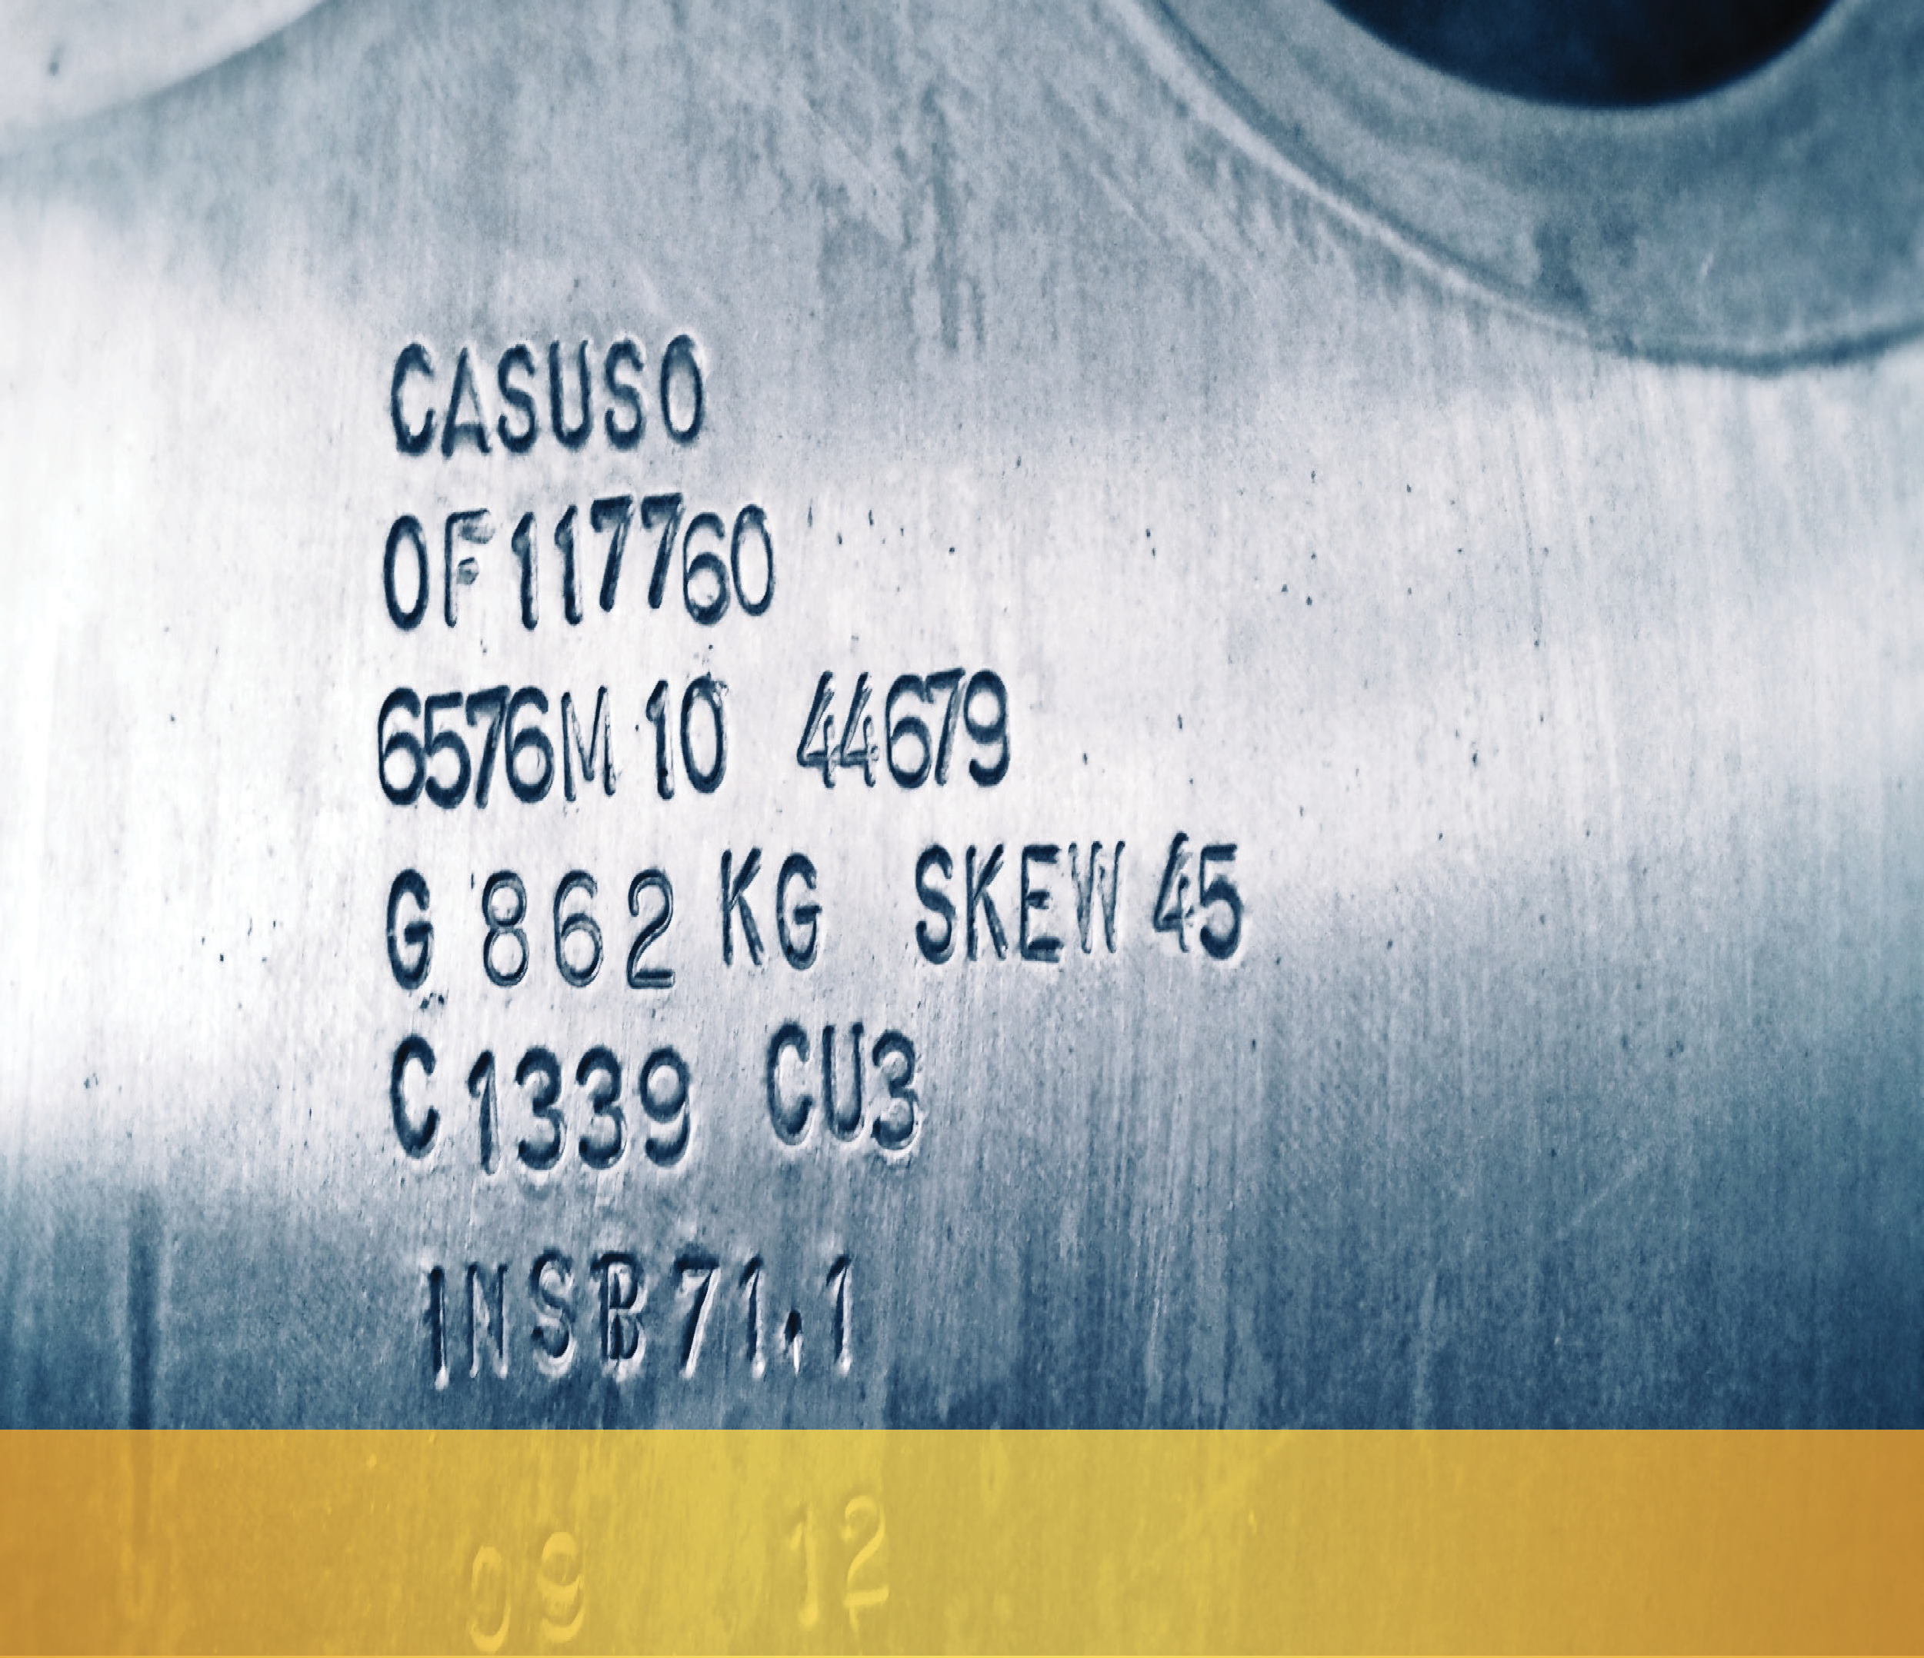

h
Quality seal
INSB Class quality assurance system is the foundation for our growth and business success.
Idocuments that enable the society to act
t is built from guiding principles and underpinned
INSB implements a fact-based approach for measurement of performance and quality improvement for its deliverables throughout its supply chain.
by a set of quality procedures and normative
responsibly and consistently, whilst supporting continuous improvement for our customers and for the wider stakeholders of the marine industry.
The effectiveness of the INSB corporate Quality Management System is certified and verified via a comprehensive external auditing process, including audits by:
The INSB corporate Quality & Environmental Policy encourages us to perform our services with consistent precision, working efficiency, with greater ability to know, and quickly respond to our customers’ changing needs.
ò
Independent Third Party Certification
ò
Delegating Flag States having authorised
ò
The Hellenic Accreditation Body (E.SY.D).
Bodies.
INSB Class activities are governed under its corporate certified Quality Management System under the EN ISO 9001 and accredited under the EN ISO 17020 international Standards.
the INSB Class.
16
NSB Class

Slide 17
















Areas of interest
A
Port State Control
To ensure long term sustainability INSB Class remains focused towards its continuous Port State Control performance improvement in the various PSC MOUs.
L
Research initiatives
INSB Class actualizes its RnD initiatives for practical methodologies to foster innovation and safety by
participation to joint initiatives with public and private organizations.
?
IMO
activities
Within the context of the international activities conducted by the Society, INSB Class participates to a number of working groups and meetings yearly by engaging its expert representatives into the Greek delegation at the International Maritime Organisation (IMO).
This upholds our factual demostration for the sustained quality of INSB classed fleet as recorded in the published PSC Annual performance listings.
Between 2013-2016, INSB
Class engaged in a EU research project, funded under the FP7 framework, with the title “Use-it- Wisely (UiW)”.
It also reflects the hard work invested by both the society and its field surveyors in ensuring that ships continue to maintain normative compliance.
INSB Class envisages its participation to additional research projects which are currently into their planning phases.
NSB Class
17

Slide 18





0
Many Flag States apply Safety
Codes of Practice to set required
standards of safety and pollution
prevention, subject to the size & type of the yachts.
Comfort & Safety combined
18
NSB Class

Slide 19






Yachting
Managing Yachts safety and compliance requirements, requires a knowledgeable partner with capabilities to the highest standards of survey and inspection.
INSB Class offers inspection and certification services for yachts (private and/or engaged in trade) as required to verify applicable safety and classification certification.
INSB Class also offers a comprehensive advisory service to builders, designers and owners of yachts under construction.
Such service also extends to cover extensive vessel conversion projects to meet desired design needs.
The expanded number of active certified yachts on the INSB register pin-point our developed dexterities and
skills for the specialised yacht segment.
K
Yachts are valuable assets.
2 Private
? Commercial
PIntermediate and a renewal survey.
Isurveys associated with the issue of the Load
leasure yachts and small craft not engaged
nspection and certification scheme for Yachts
in trade, are usually subjected to an initial, an
over 24 meters & engaged in trade embraces
Pleasure yachts irrespective of their size are subject to MARPOL Convention requirements.
Line certificate, Safety Construction and MARPOL certificates, as applicable.
INSB will issue the appropriate certification following the successful initial or renewal survey.
Safety Codes of Practice as enforced by each delegating Flag Administration are checked and verified for compliance during inspections.
INSB will issue the appropriate certification following the successful initial or renewal survey.
NSB Class
19

Slide 20







Locations
Headquartered in Piraeus, Greece and backed by an expanding number of regional offices and field survey stations in all major ports worldwide, contact with us is really 24|7|365.
O
ur people have an understanding of your service expectations, your region’s condi- tions and prevailing regulations you antici-
From the early stages of new building to the systematic survey and certification, we have the know-how and resources that makes sense to your company and your vessels.
pate from a reliable maritime partner.
We are positioned to closely monitor developments in the industry and the local markets by expanding our local presence and service points.
Our committed professionals provide decisive support and assistance from the critical design phase, during construction and throughout the entire service life of your fleet.
Building on INSB’s marine competence, experience and international presence, we help add value to your business almost anywhere in the world.
main offices
INSB AMERICAS- LATIN AMERICA
Ricardo J. Alfaro Avenue,
El Dorado, 16 West Street, Office 16, Po Box 0830-00968,
Panama City, Panama T: +507 279 1474
E: americas@insbamericas.com latintech@insbamericas.com
INSB BULGARIA LTD
11 Vazrazhdane Street, Bourgas 8000, Bulgaria
T: +359 56 879040,879050
E: office@insb-bulgaria.com website: W: www.insb-bulgaria.com
INSB HEAD OFFICE:
8 Kantharou & Sachtouri 185 37, Piraeus Greece
T: +30 210 4184172, 4532529, 4537993
F: +30 210 4184282
E: insb@hol.gr W: www.insb.gr
INSB MEA SAL
Zalka, Main Road., White Building 1st Floor, Beirut , Lebanon
T: +961 4 710246, 715928, 712941
E: admin@insb-mea.com W: www.insb-mea.com
INSB ARGENTINA
277 Peru Str, 3rd Floor- Dept "2" (C1067AEE) Ciudad Autonoma De Buenos Aires, Argentina
T: +54 11 5235 5423
E: issb@issb-ar.com
INSB CARIBBEAN
30-32 Red Hills Road, Unit 38
Kingston 10, Jamaica
T: +1 8764090412
E: insb.caribbean@gmail.com
INSB BRASIL
03 Venezuela Avenue, 11th Floor Suite 1111, Saude - (20081-311),
Rio De Janeiro, Brasil
T: +55 21 2253 4918, 2233 3353
E: insb.bra@sascgroup.com
INSB CYPRUS
143, Spyrou Kyprianou Avenue, Chrysanthou Business Center 3083 Limassol, P.O. Box 56889-3310, Cyprus T: +357 25 004555
E: info@insb-cy.com
ADDITIONAL INSB SERVICE LOCATIONS
Australia | Bangladesh | Canada | China | Denmark | Ecuador | Egypt | France | Ghana | Italy | Japan | Jordan | Kenya | Korea | Madagascar Singapore | South Africa | Spain | Sudan | Syria | Taiwan | Togo | Tunisia | UAE | Venezuela
20 NSB Class

Slide 21






together
we do more
INSB INDONESIA
Bumi Eraska Cibuburm, Blok D2. No 75, RT.06, RW.04, Jati Raden, Jati Sam- purna Jl, Kranggan Raya, Bekasi 17434 Indonesia
T: +62 8128 923 8674
E: doniarsal.nurdin@insb-indonesia.com
INSB SOUTH PACIFIC LTD
Po Box 3104, Shortland Street, Auckland 1140, New Zealand T: +64 9 444 6873, 214 83725
E: kaz@insbsouthpaciﬁc.com
INSB UKRAINE
1, Odesskaya Sq., Kherson 73010, Ukraine
T: +380 55 2421540, 2421540
E: office@insb.org.ua
INSB NIGERIA LTD
8 Liverpool Road, Gra Apapa, Lagos, Nigeria
T: +234 1 7367265 , 7741189
E: survey@insb-nigeria.com W: www.insb-nigeria.com
INSB PHILIPPINES INC
Level 10-1 Fort Legend Tower, 31st St. & 3rd Avenue, Bonifacio Global City Taguig City, Metro Manila, Philippines T: +63 222 42106
E: mail@insb.ph W: www.insb.ph
INSB SRI LANKA
No. 18/179B, Dabare Mawatha, Colombo 05, Sri Lanka
T: +94 777 895992
E: insb_lanka@sltnet.lk
INSB UNITED KINGDOM
56 Holland Park Road, West Kensington, London W14 8lz, United Kingdom
T: +442 07 6038520
E: elsmore@elsmoreshipping.com
INSB NORDIC AB
Kofferdigatan SE 602 28 Norrkoping, Sweden
T: +46 11 287830
E: mail@insb.se W: www.insb.se
INSB U.S.A INC
5200 N. Federal Highway #2 Fort Lauderdale FL. 33308, USA
T: +1 954 62 8358
E: mail@insb-usa.com
INSB NORTH WEST EUROPE bvba
Hogebaan 51, Bus2 ,B-2960, Brecht Belgium
T: +32 3 225 0128
E: info@insb-nw-europe.com
INSB TURKEY
Sahilyolu Blv, Mine Sok. No 3/2 34903 Guzel Yali , Pendik Istanbul, Turkey
T: +902 16 4941193
E: insb@insb.com.tr
ADDITIONAL INSB SERVICE LOCATIONS
Monaco | Montenegro | Morocco | Norway | Pakistan | Portugal | Romania | Russia | Saudi Arabia | Senegal | Slovenia
NSB Class
21

Slide 22



Features do not make people happy.
Beneﬁts do.
22
NSB Class

Slide 23




Fuel your competitive advantage
Why work with INSB Class
ì
We carry 4 decades of developed
ì
Offering specialized competencies.
î
dynamics and potentials.
î
Maintain structural & mechanical
Speeding up our key operational
procedures to achieve further efficiency.
efficiency.
ì
Strengthening the INSB technical
ì
International acceptability & recognition.
î
presence in growing markets.
î
Continuously improve INSB
performance in Port state control ensuring quality recognition of the classed fleet.
requirements.
Conformance with Statutory related
ì
Reduced response times while ensuring
ì
Compliance with Underwriters criteria
optimum and reliable performance of our services.
and insurance policies.
î
Ensuring quality growth for the classed
î
Updated enforcement of Safety
Regulations & Codes.
fleet.
We have the Greek Maritime Tradition We are a Greek Society
We are INSB Class
NSB Class
23

Slide 24










Start at
www.insb.gr/contact
INSB Class - Head Office
8, Kantharou & Sachtouri street 18537, Piraeus
GREECE
P: (+30) 210 4184172, 4532529, 4537993
F: (+30) 210 4184282
E: insb@hol.gr W: www.insb.gr
INSB Class - Proﬁle May 2014
Last Update: Feb.2016
INSB Class

