Slide 1
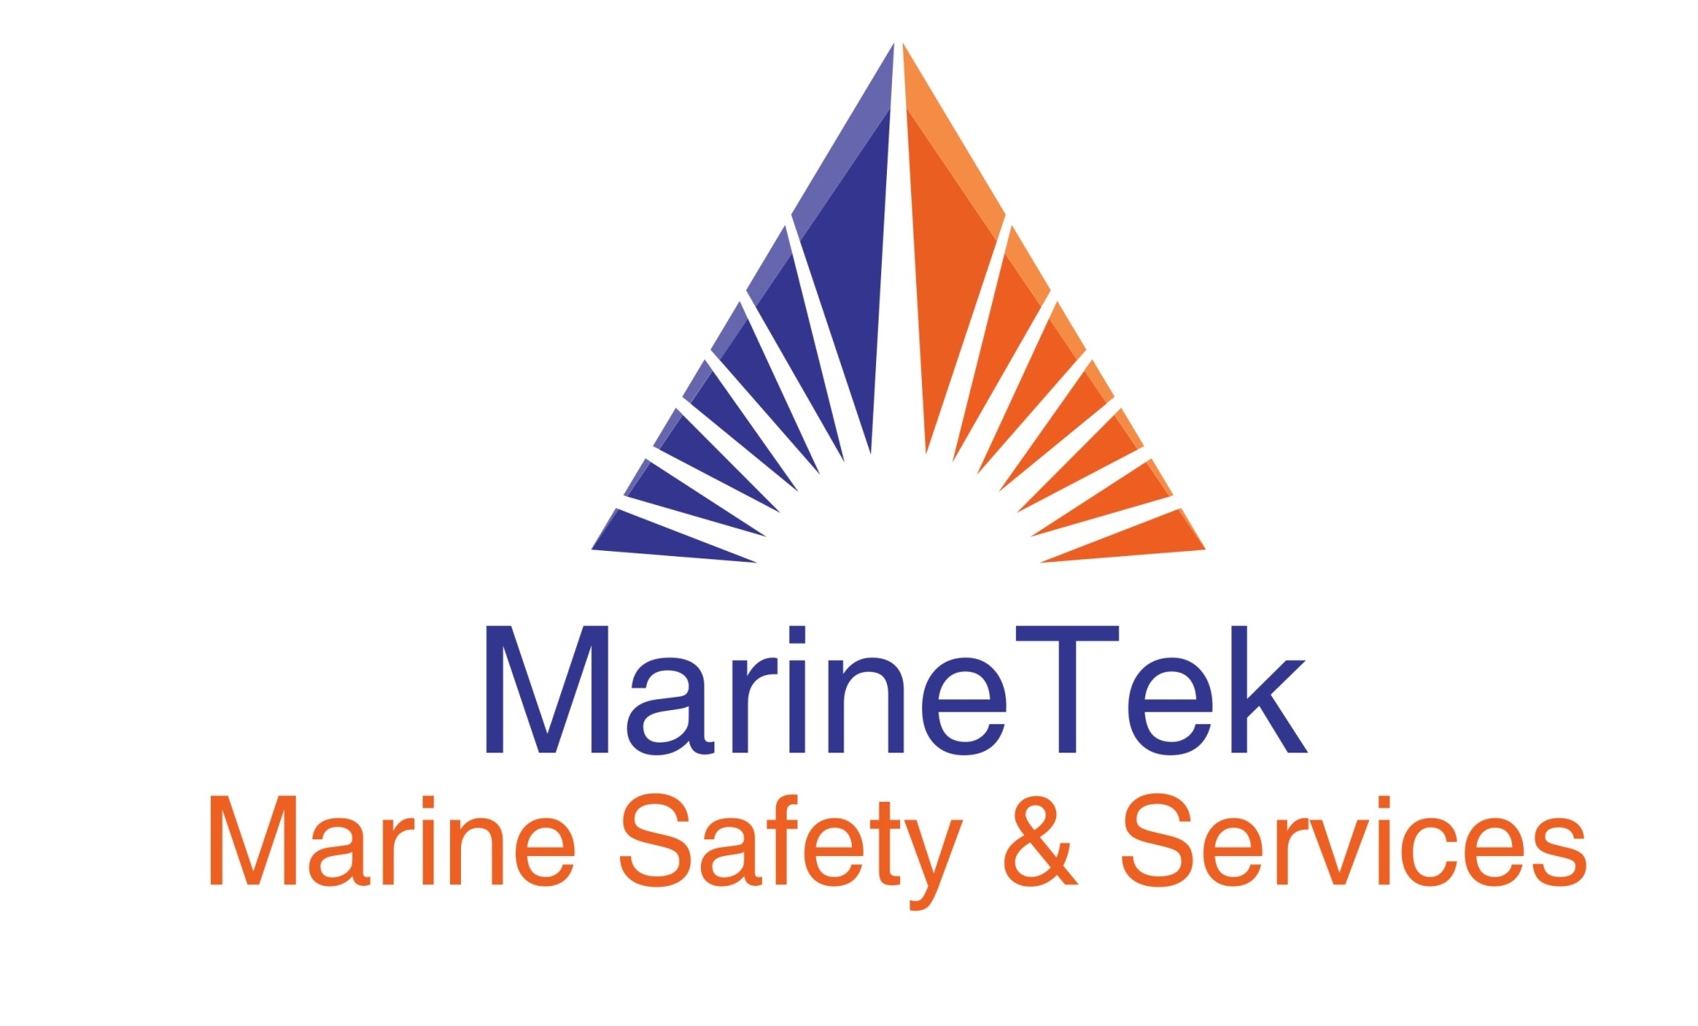

Slide 2
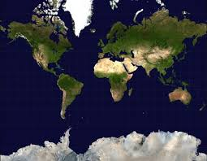
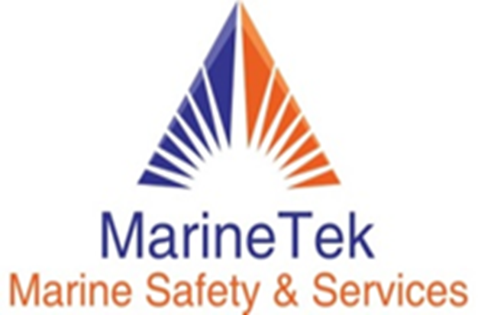
Marinetek its been formed with professionals with over 30 years of experience linked to the Maritime Industry , positioning our company able to provide with our vast experience in different types of operation and vessels a high level of services to our clients in the Technical areas
In MARINETEK we are constantly searching for innovative formulas to provide better solutions
We at MARINETEK, Follow Work processes consolidated, based on the best practices , management systems and high levels of quality and excellency

Slide 3
Contribute to the safe, reliable, economically sustainable and financially profitable operation in the industrial and maritime technical management, in the areas of maintenance, supplies, inspections, consultancies, certifications, consultancies, metrological calibration services, services to maritime and industrial safety equipment , oriented and supported to customer satisfaction, based on regulations in accordance with local authorities and compliance with national and international regulations preserving and protecting enviroment

Slide 4
.
To be leaders in Latin America and the Caribbean in Technical Management, Calibration of metrological equipment and safety equipment in the maritime and industrial area

Slide 5
sderere
Marintek Values
Integrity
Honesty
Excellence
Compromise and responsibility
Respect
Teamwork
Job security
Crystal clear and Brutal communication
Customer service
Business orientation

Slide 6
MarineTek, a leading organization in the provision of Industrial and Maritime Management services, we are committed to protecting the environment, providing safe and healthy conditions to our stakeholders, meeting their needs and expectations, complying with legal requirements and other applicable requirements, with the consultation and participation of workers and their representatives, emphasizing the continuous improvement of the Integrated Management System of ISO / IEC 17025: 2017 and ISO 9001: 2015

Slide 7
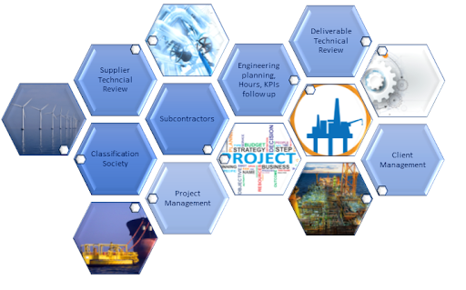
Management and maritime technical administration Life raft service station Calibration lab Marketing and supply
Representative in Colombia and Caribbean for Industry companies including Class
Marinetek services

Slide 8
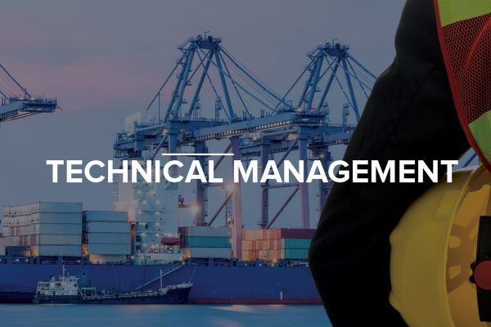

Slide 9
Marinetek has been FORMED with professionals with more than 30 years linked to the MARITIME industry, finding in our company a vast experience capable of providing in the different types of operations and vessels a high level of support to our clients in the technical area with the maximum professionalism.
All those years at sea and at the management level provide a unique perspective, with a wide variety of elements that are needed and used by companies in the maritime industry.

Slide 10
TECHNICAL MANAGEMENT
At MARINETEK, we are constantly looking for innovative formulas to meet the multiple needs or technical or supply challenges that our customers may have. We have consolidated work processes, based on best practices, integrated management systems and high levels of quality and excellence.

Slide 11
Vast Experience gathered worldwide in different and challenging Operations
Tugboats-Deep Sea, Harbour,Salvage
DP2 AHTS
PSV-FSV
Construction Vessels
Geotechnical & Geophysical vessels
Lift Boats
General Cargo Vessels
LPG Vessel
Ro-Ro Vessels
Container Vessels
Floating Transfer Station
Bulk Carriers
Crane Vessels
Lay Pipe Vessels
Drydock repairs
Major Repairs Afloat
Project Management

Slide 12
Marinetek specializes in:
Technical Management
Implementation and control of Preventive Maintenance
Dry-docking Specifications and supervision
Project Manager for vessels Upgrading and Ship repairs
Technical Advice for Project development

Slide 13
• Development of ISM technical manuals / procedures • Technical advice in the preparation of ISPS manuals
• Internal audit for ISM / SMS / ISPS
• Technical inspections such as: OPS preparation, Pre-purchase inspection, imca guidelines, Pre-vetting, CAP inspections,OCIMF-SIRE using the most efficient tools available in the industry and supported by the corresponding library
Marinetek specializes in:

Slide 14
TECHNICAL MANAGEMENET is responsible on all technical aspects of vessels. Ensuring Team Performance up to the estipulated expectations in the job description,Core Values KPI HSSEQ plans to ensure vessels performing without downtime or commercial losses to the satisaction of clients while expenses are within budget
Technical management overview

Slide 16
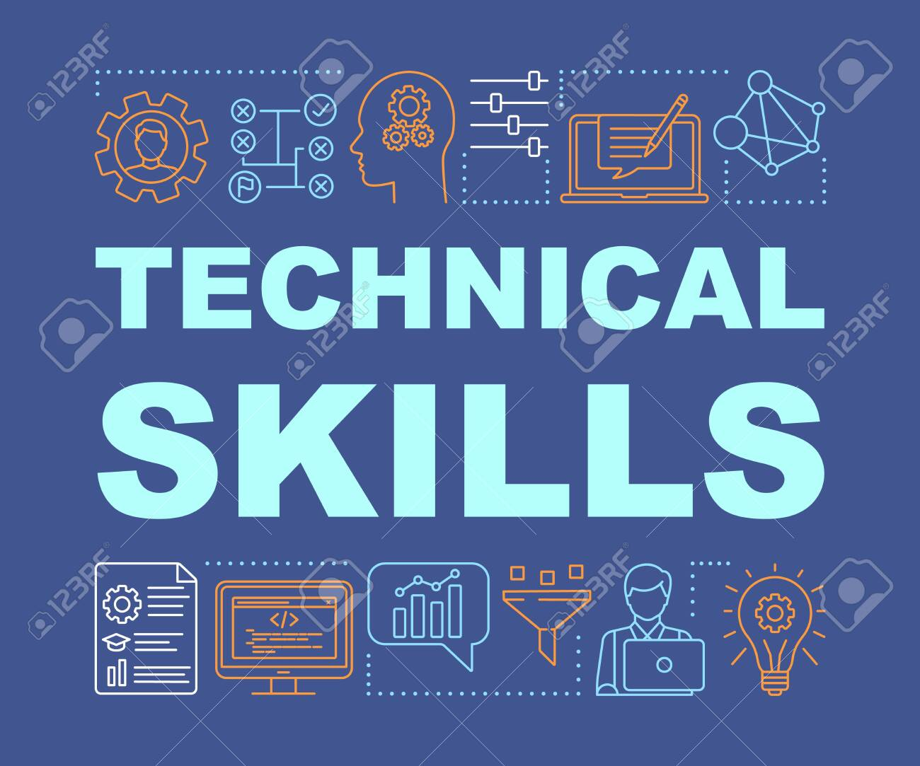

Slide 17
Calibration Laboratory

Slide 18
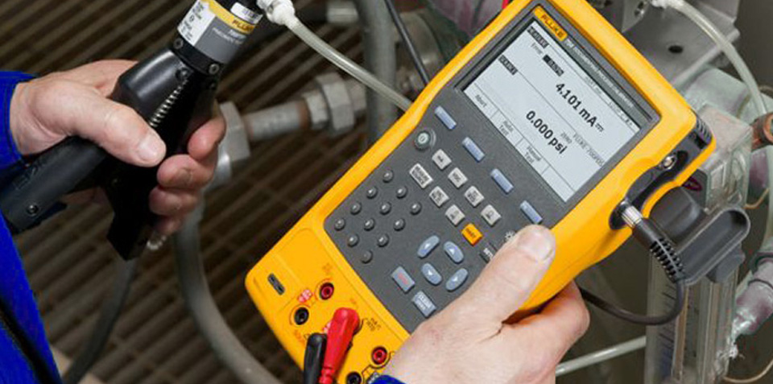
calibratión
Laboratory
MARINTEK Lab specializes in recalibration and control of industry Instruments
We work under a management system based on ISO 17025:2017 currently under verification with ICONTEC)
In Our Lab we count with equipment of the higher standards to provide a top of the line Service.
We Perform calibration on instruments of control for:
Pressure
Temperature
Gases

Slide 19
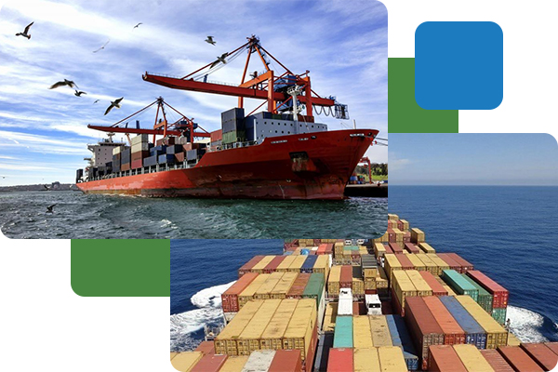
Marinetek, provides with an efficient plattaform solutions with Logistics issues to its clients within national and international market
Logistics Support

Slide 20
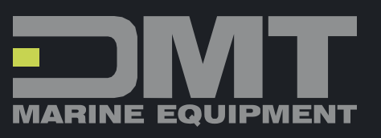
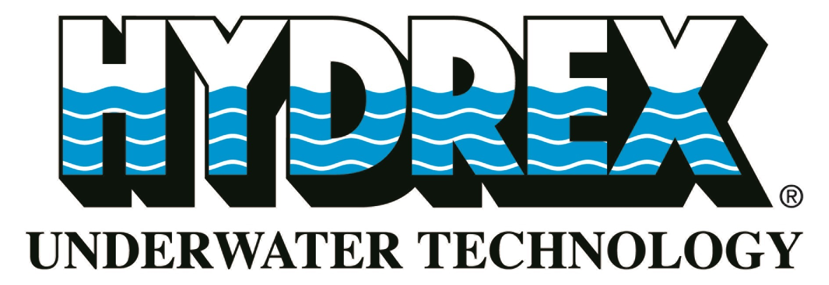
MARINETEK REPRESENTS IN COLOMBIA AND CARIBBEAN

Slide 21
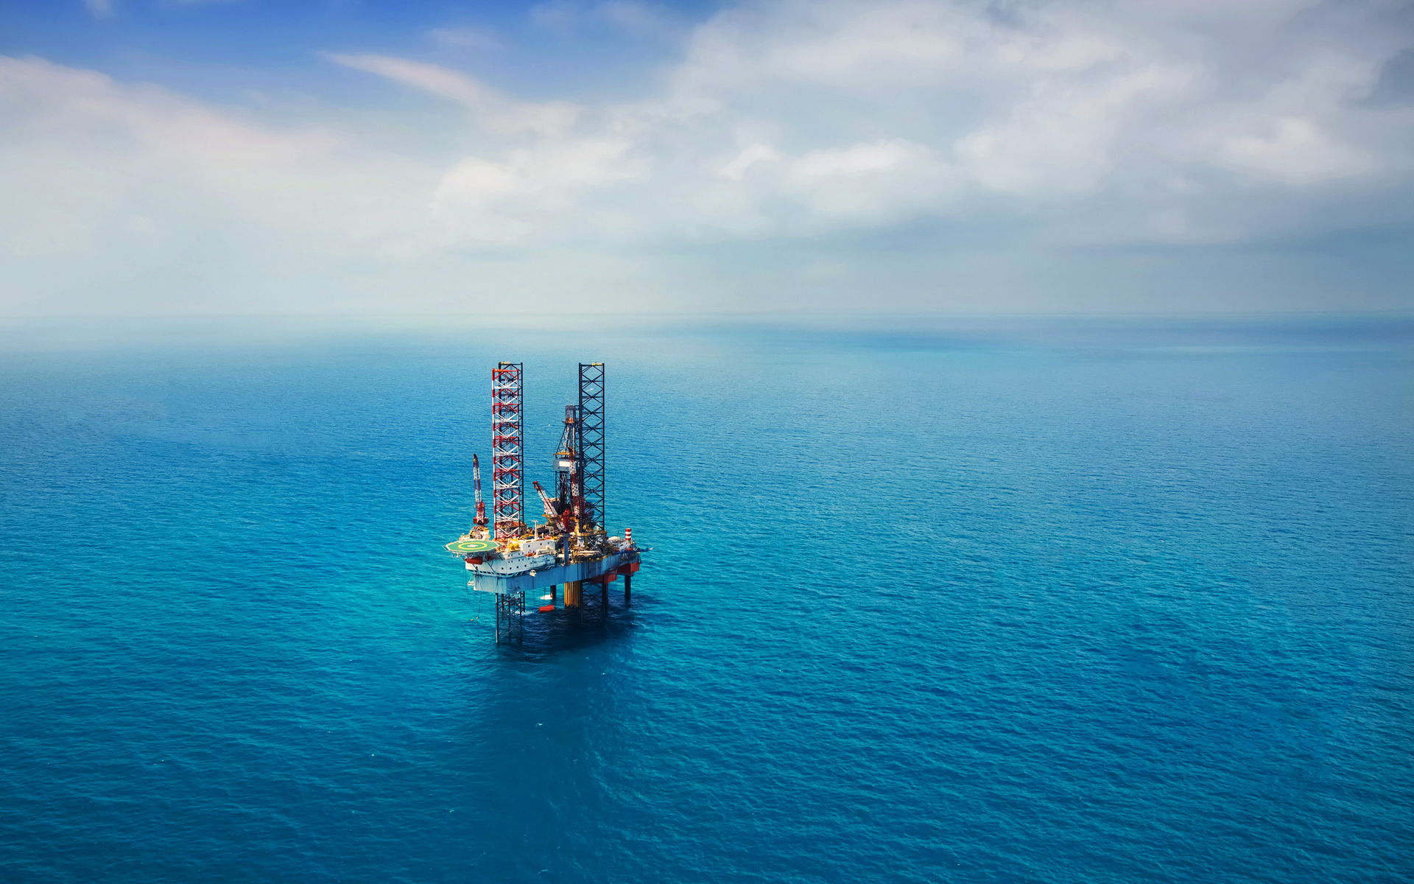
OUR CLIENTS
LOGTRASOL C.A
SERSINCA S.A
INTERMAR Shipping
ASTIVIK
GREMEX Shipping
GEOCEAN
GEOMARES
GULF LAKE Ltd
TRIMECA S.A.S
INTERTUG
GLOBAL Vzla
Don ANDRES
MIDNIGTH OFFSHORE
TRINITY GROUP
IOCLTT
BUMI ARMADA
AGENCIA OCEANBLUE
NAVIERA INTERGRAL
OCEANBAT
CAPITAL SIGNAL
DAMEN CURACAO

Slide 22
Claudio santellanes
Operations Manager
operations@marinetek.org
+57 300 6525713
+ 17865089831
Jonathan carrillo
Technical Supt
techservices@marinetek.org
+57 313 3845935
www.marinetek.org

Slide 23
In MARINETEK we believe that we are an ASSET for your Organization and we pledge our skills and professionalism to your Services

