Slide 1
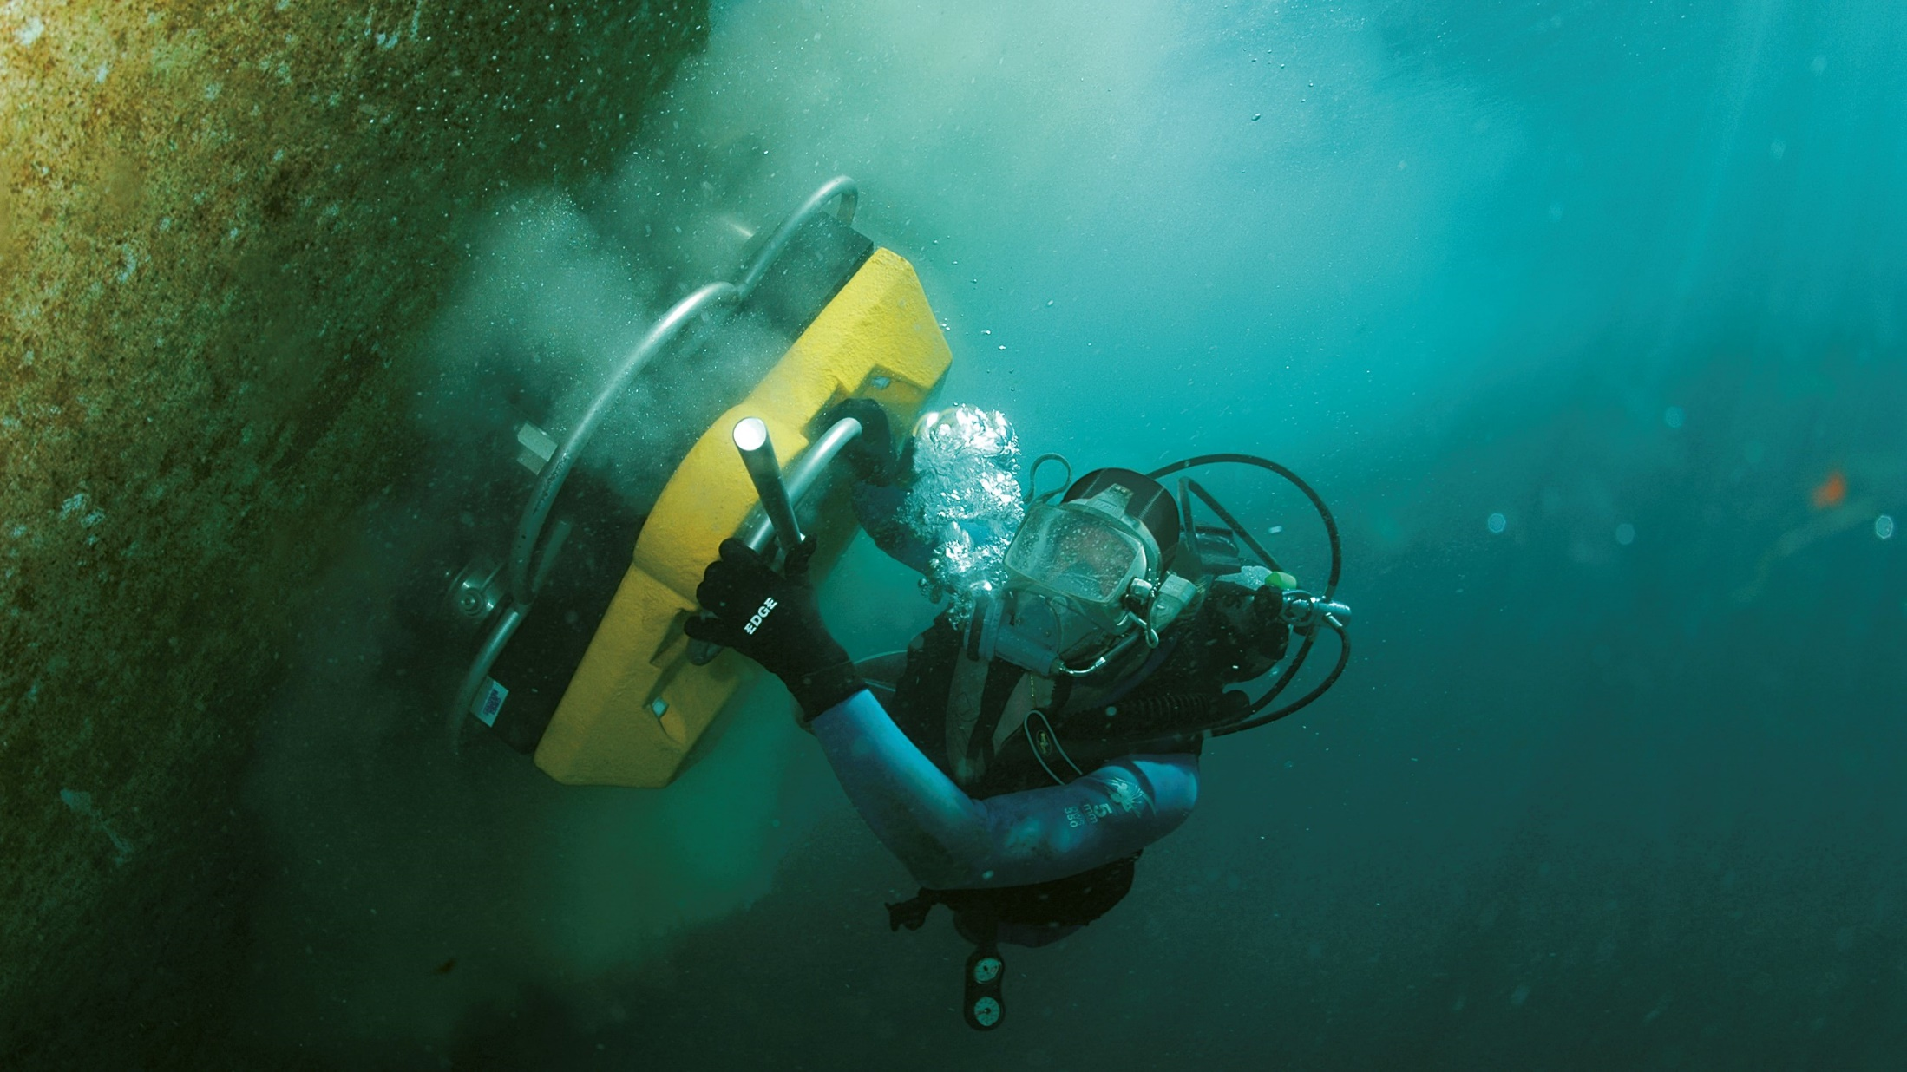
Superior coatings and underwater cleaning systems

Slide 2
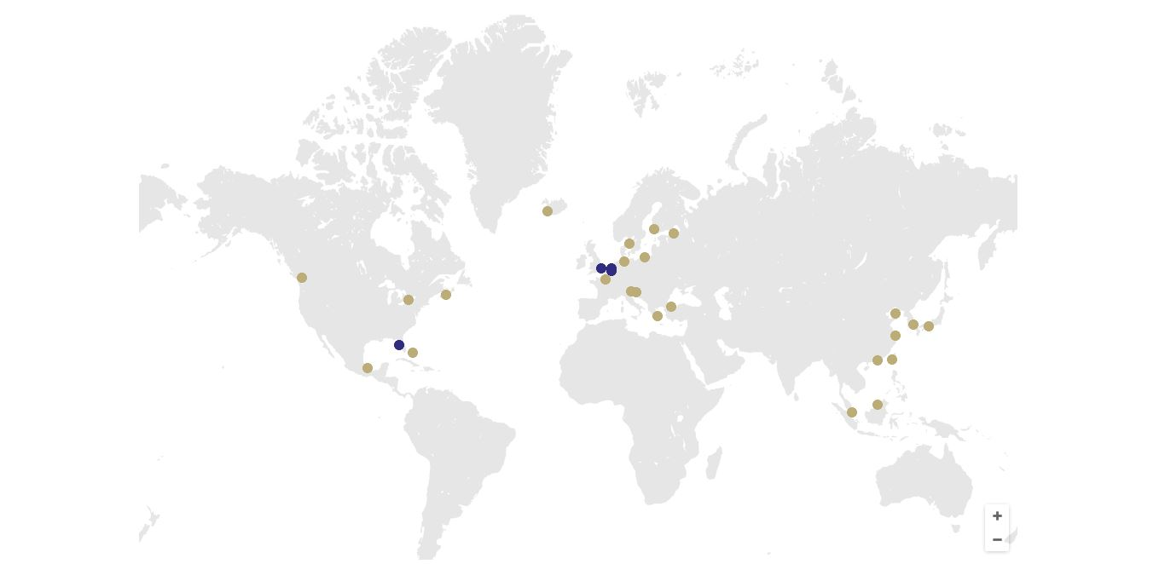
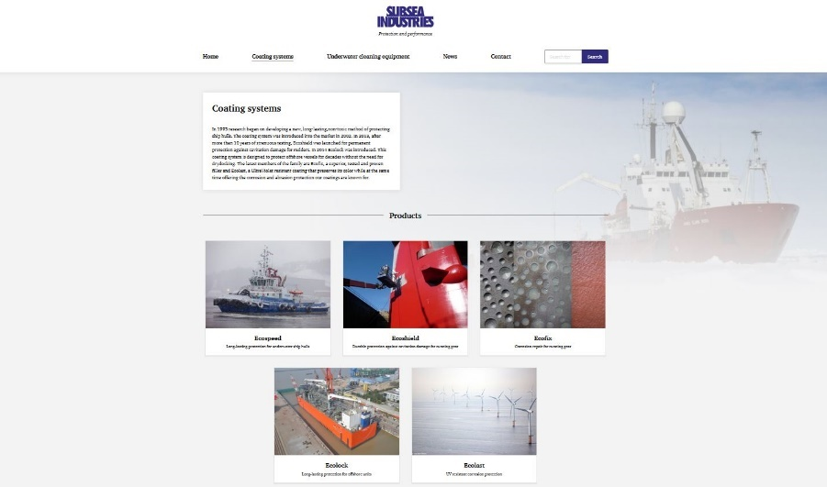
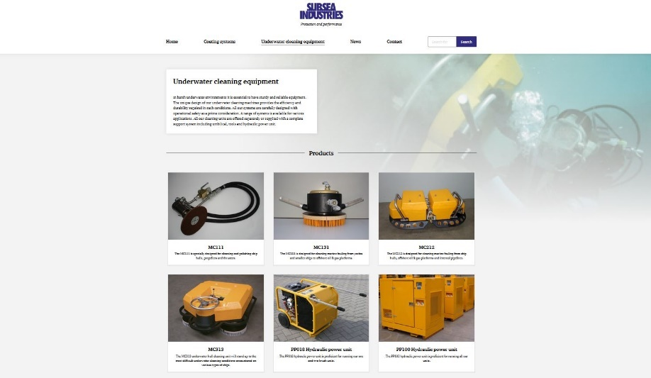
Subsea Industries products
Coating systems
Underwater cleaning equipment

Slide 3
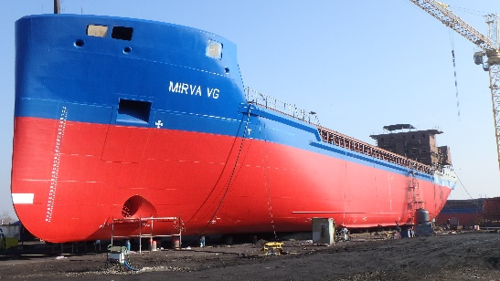
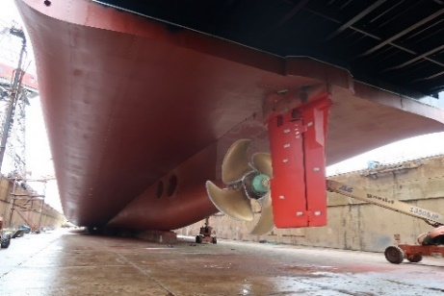
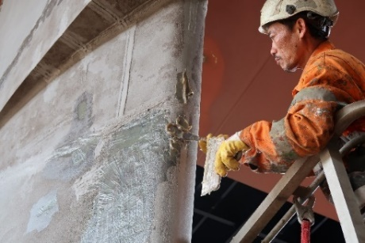
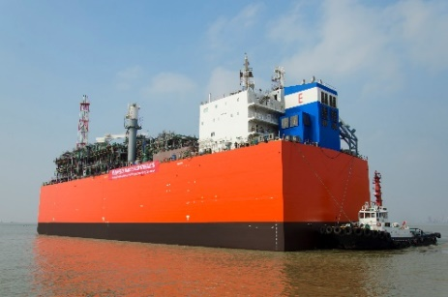
Coating systems
Durable VEGF coating used for corrosion protection and ship hull performance. - Ship hulls - Ballast tanks - Storage tanks - Pipelines | Extremely durable VEGF coating used for cavitation damage prevention. - Rudders - Nozzles - Thrusters - Thruster tunnels | Pitting repair before Ecoshield/Ecospeed application. Superior adhesion between substrate and VEGF. - Pitting repair - Rudder slots | Superior corrosion protective VEGF coating for stationary submerged objects. - Floating offshore units - Stationary structures | Superior corrosion protective and color stable VEGF coating for offshore splash zones. - Monopiles - Offshore foundations
VEGF: vinylester glassflake

Slide 4
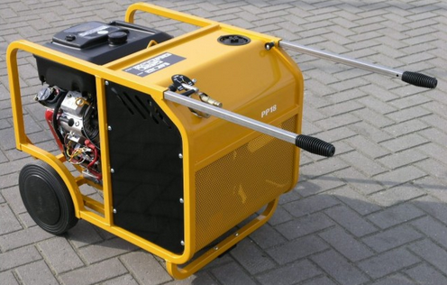
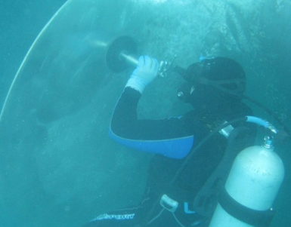
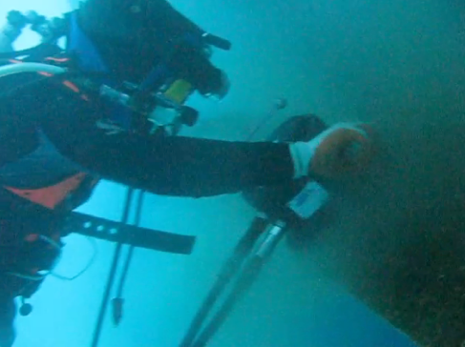
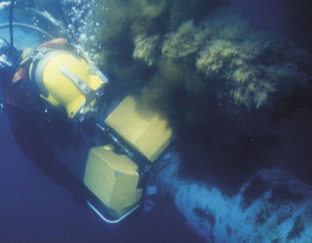
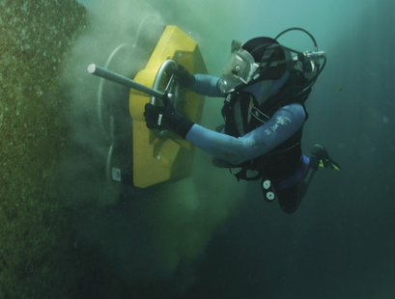
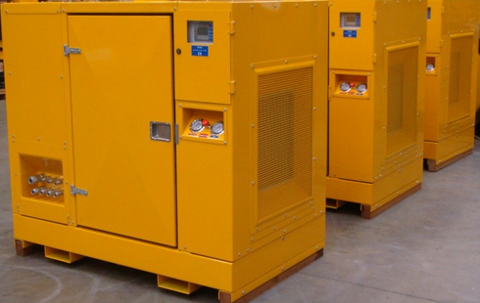
Underwater cleaning systems
MC111 | MC131 | MC212 | MC313 | Power units
Is designed for cleaning and polishing ship hulls, propellers and thrusters. Weight: 5 kg 20 ltr/min @ 140 bar | Is designed for cleaning marine fouling from smaller ships to offshore oil and gas platforms. Weight in air: 9 kg Weight in water: 1 kg Cleaning: 300 m²/hour 20 ltr/min @ 140 bar | Is designed for cleaning marine fouling from ship hulls, offshore oil and gas platforms and pipelines. Weight in air: 23 kg Weight in water: 1 kg Cleaning: 450 m²/hour 40 ltr/min @ 140 bar | This underwater hull cleaning unit will stand up to the most difficult underwater cleaning conditions encountered on various types of ships. Weight in air: 133 kg Weight in water: 10 kg Cleaning: 1500 m²/hour 80 ltr/min @ 140 bar | PP018 power unit Suitable for running: MC111/MC131/MC212 PP100 power unit Suitable for running: MC111/MC131/MC212/MC313

Slide 5
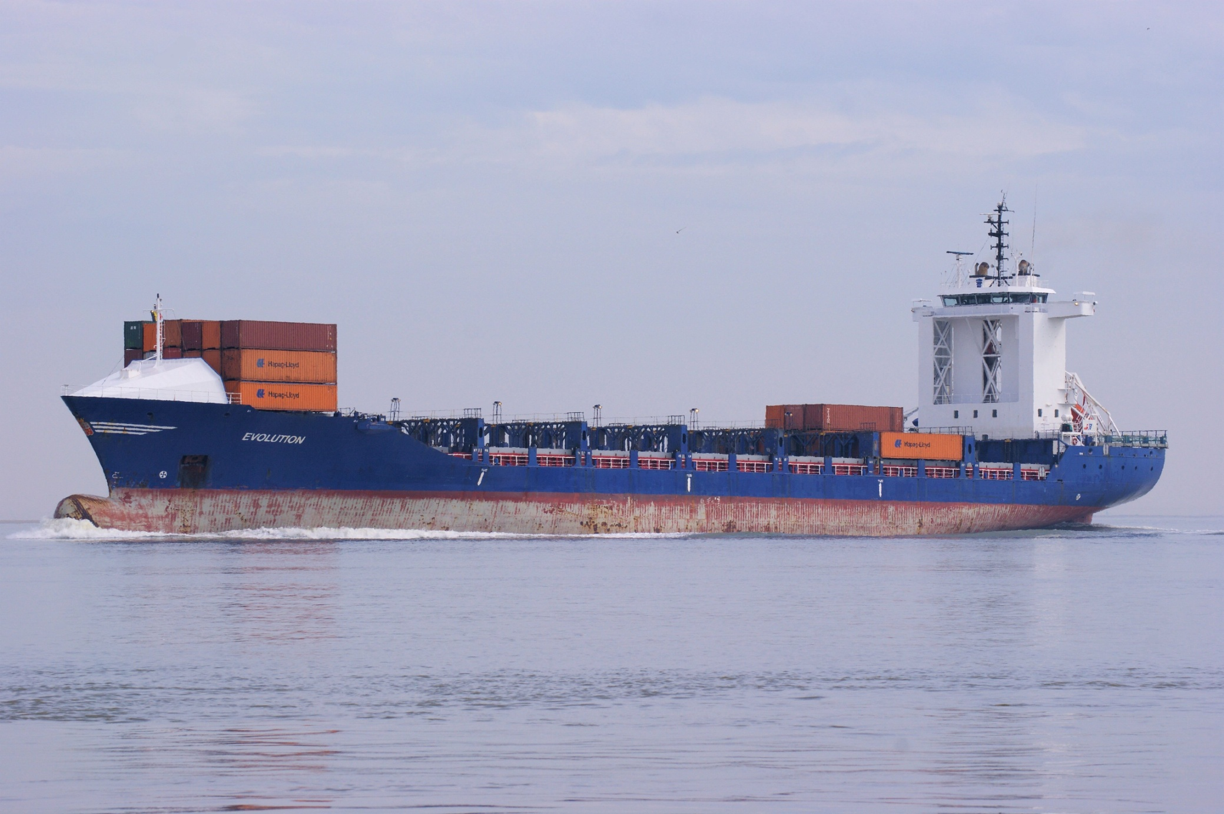

Slide 6
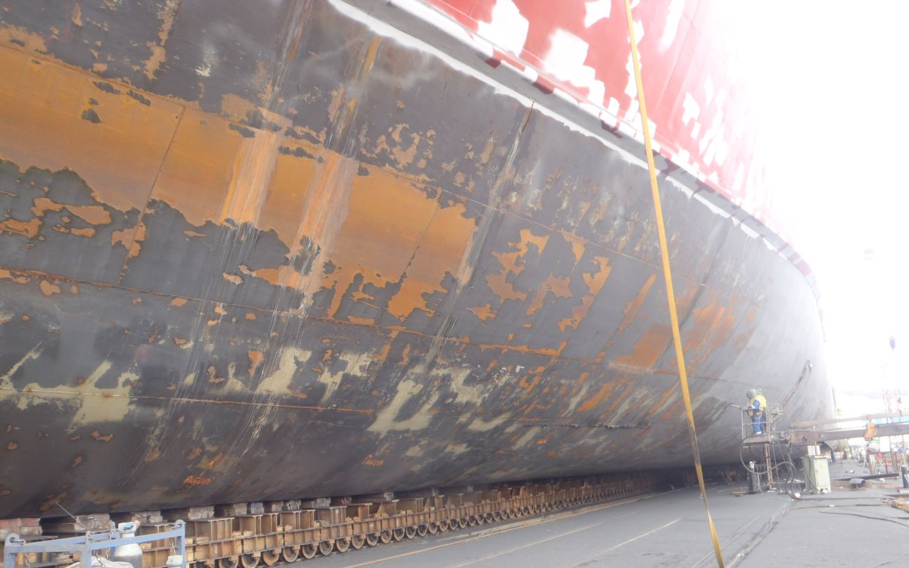
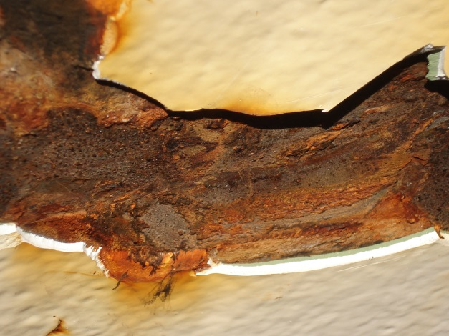
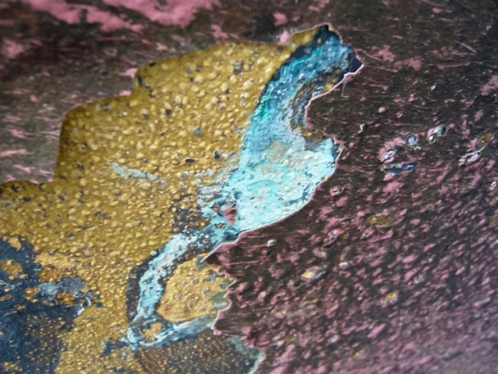
Deterioration of hull coating – the hidden cost

Slide 7
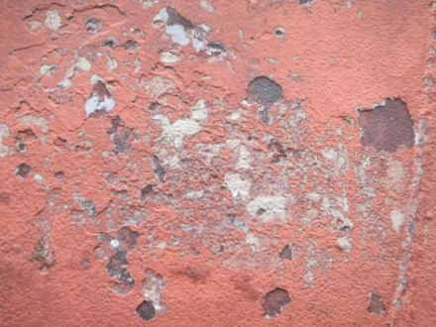
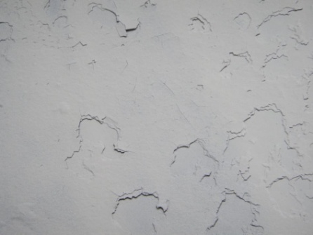
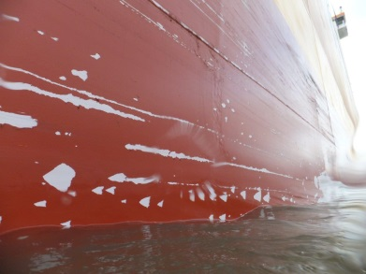
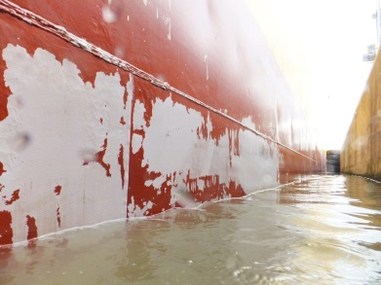
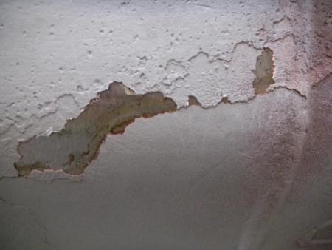
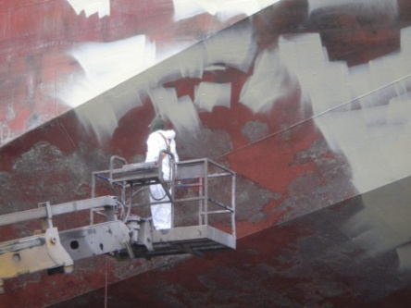
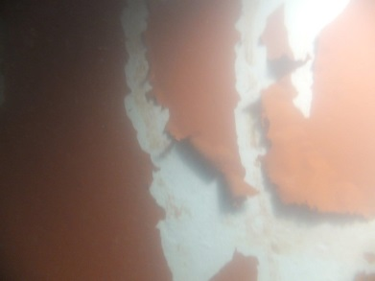
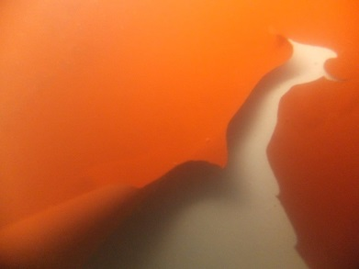
Classic problems with conventional coating systems
SPC coatings systems
Foul release coatings systems

Slide 8
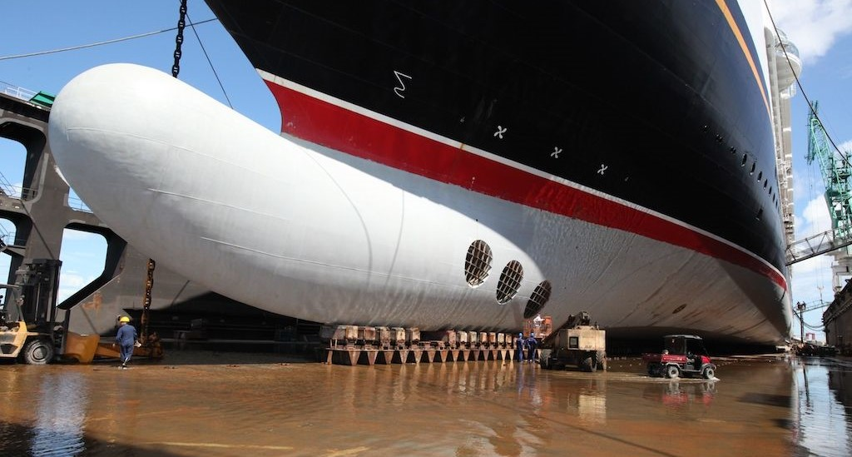
Ecospeed: durable protection system
ECOSPEED® after 2 years in operation

Slide 9
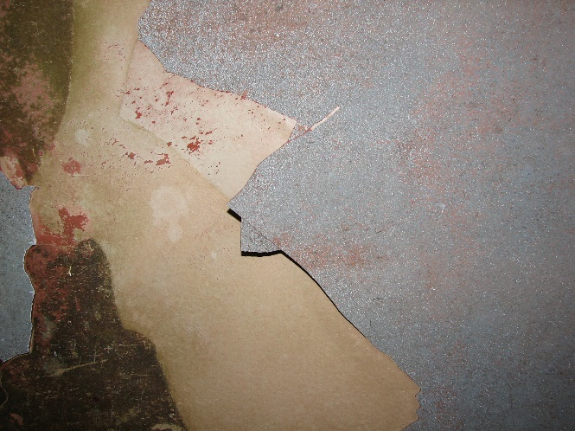
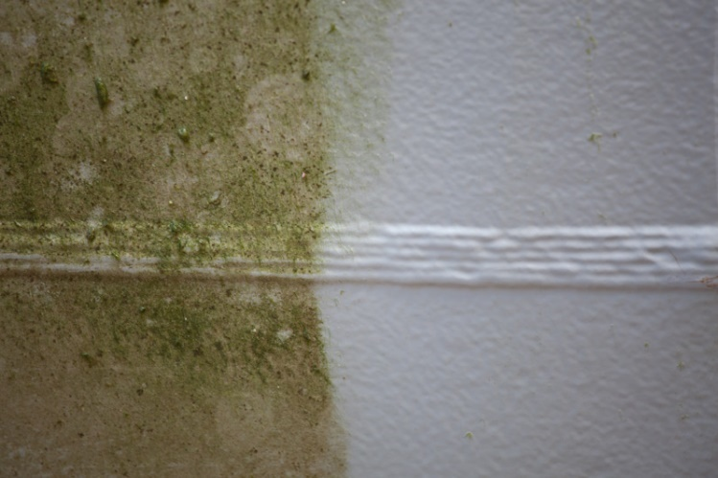
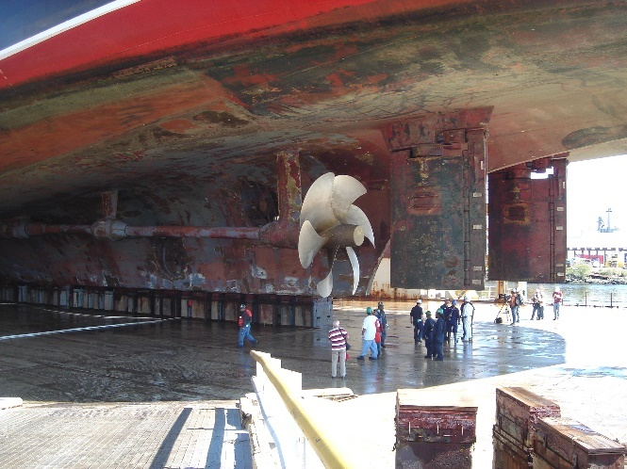
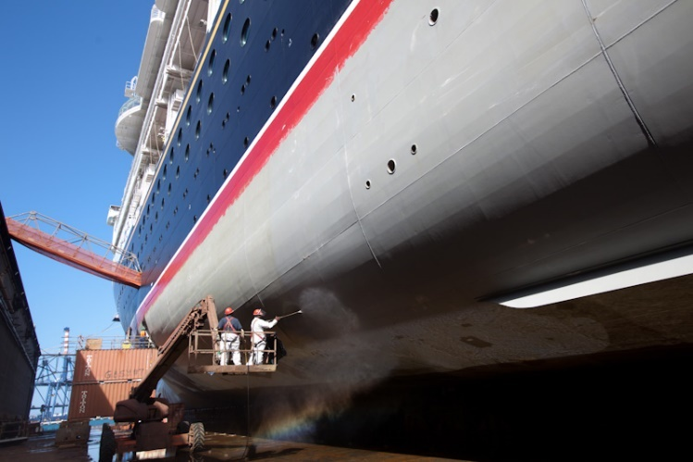
Conventional system versus Ecospeed
Conventional system after 2 years
ECOSPEED® after 2 years

Slide 10
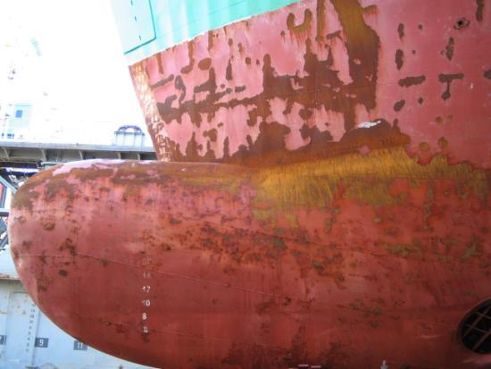
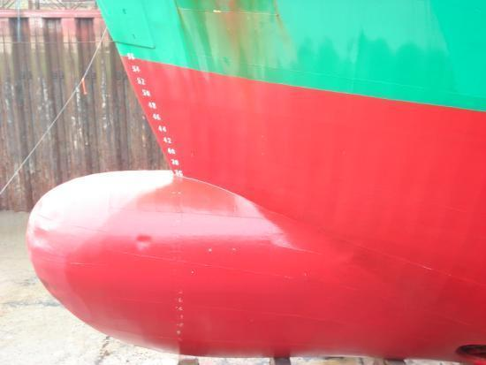
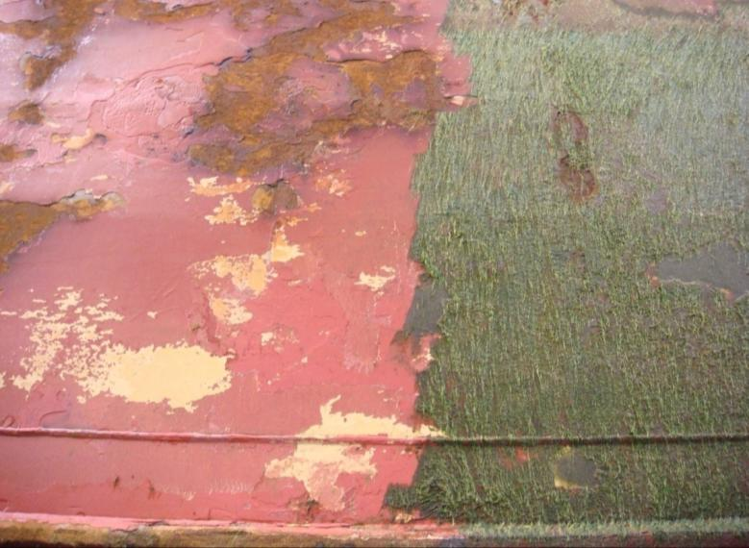
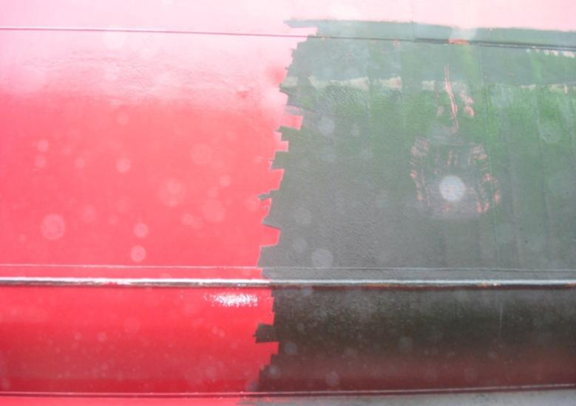
Conventional system versus Ecospeed
Conventional system after 18 months
ECOSPEED® after 24 months

Slide 11
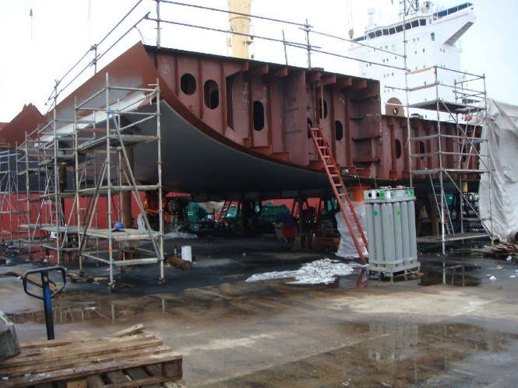
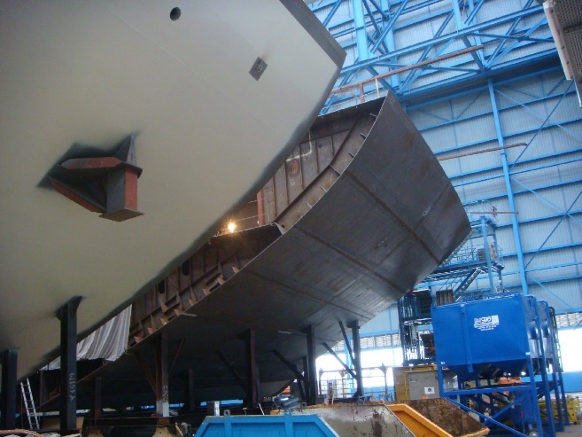
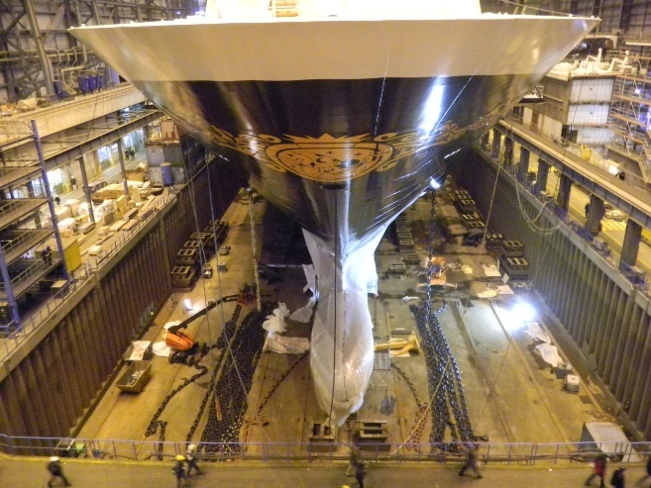
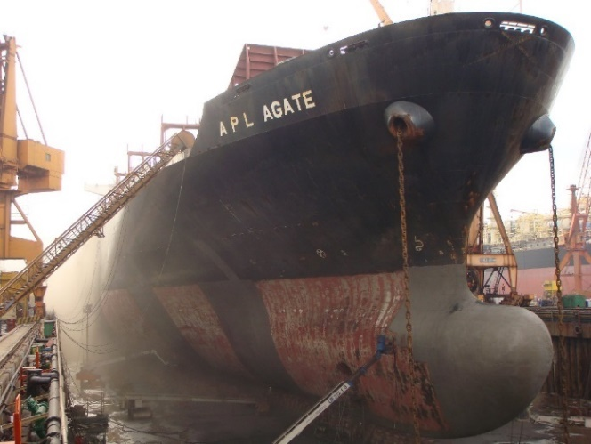
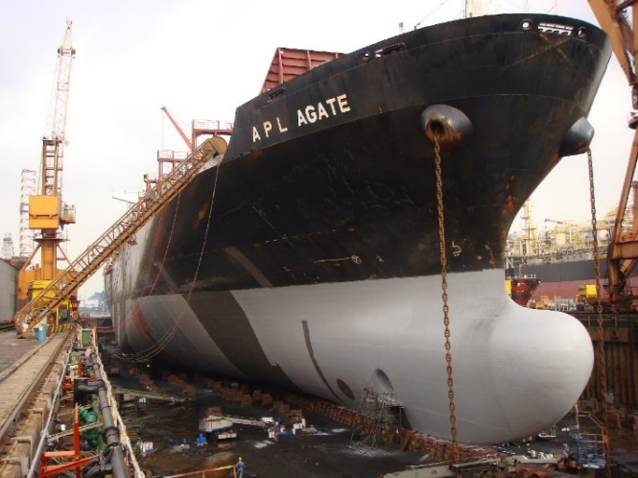
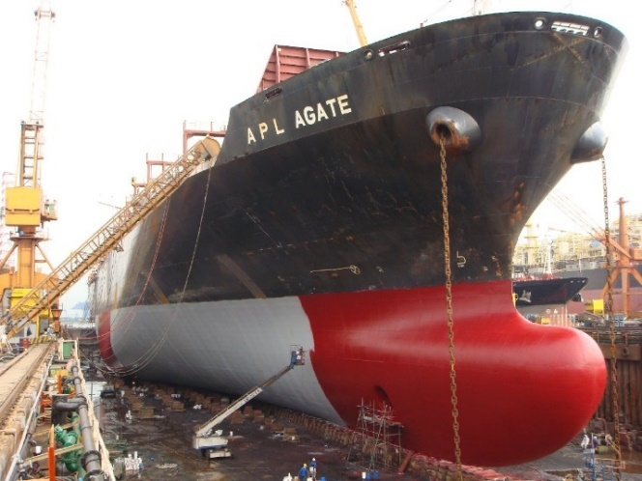
Application of Ecospeed
New build applications
Application in shipyards

Slide 12
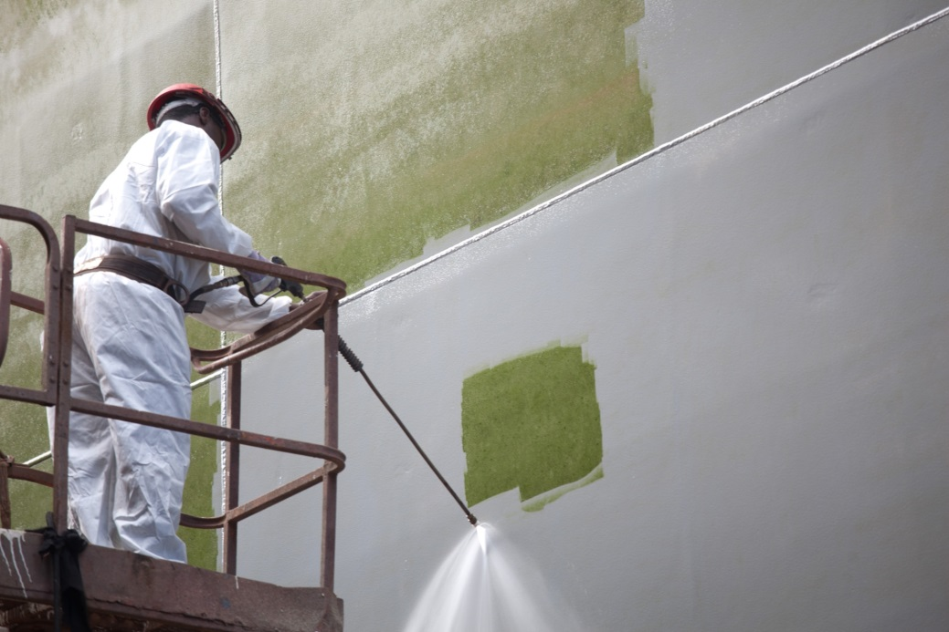
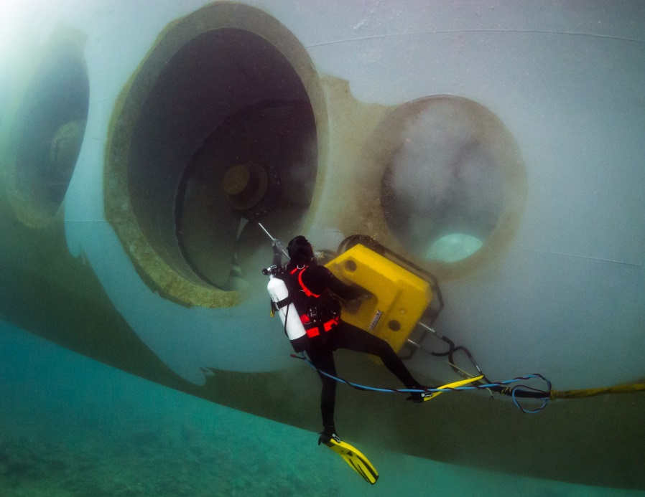
Cleaning Ecospeed

Slide 13
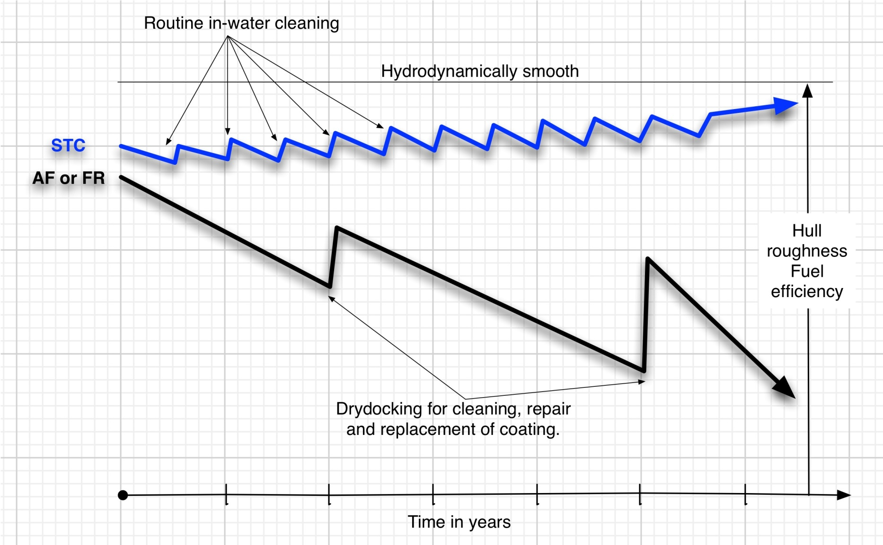
Hull performance and efficiency technology

Slide 14
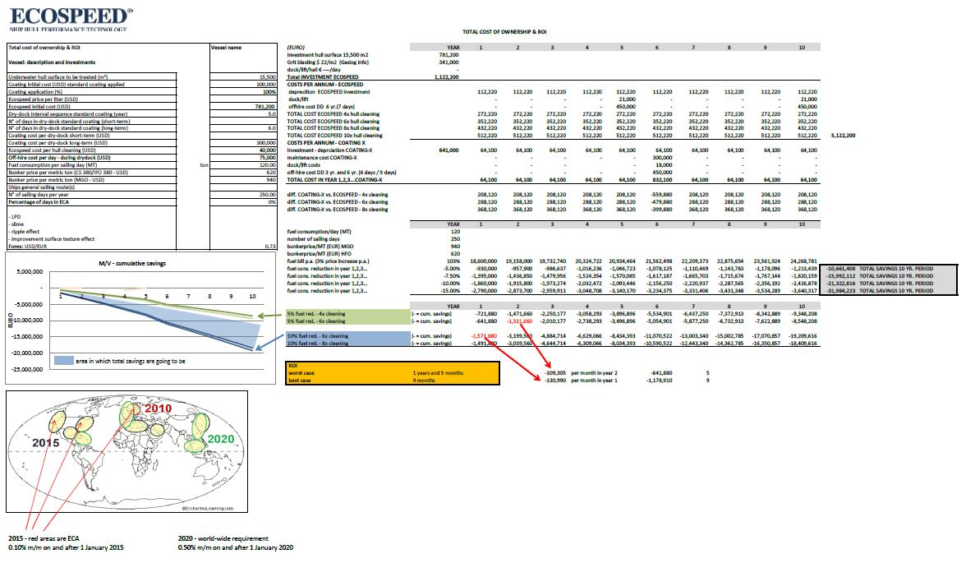
Total cost of ownership calculation

Slide 15
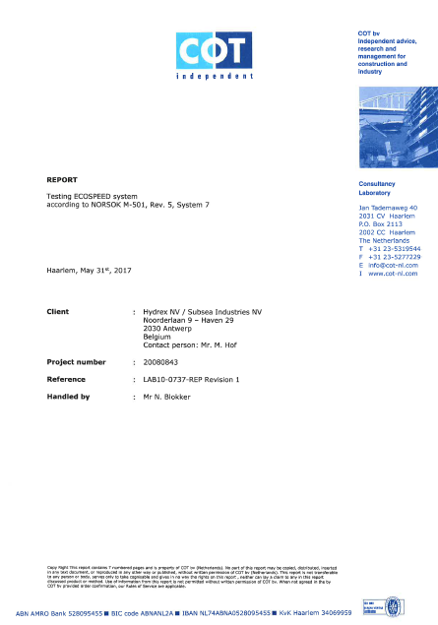
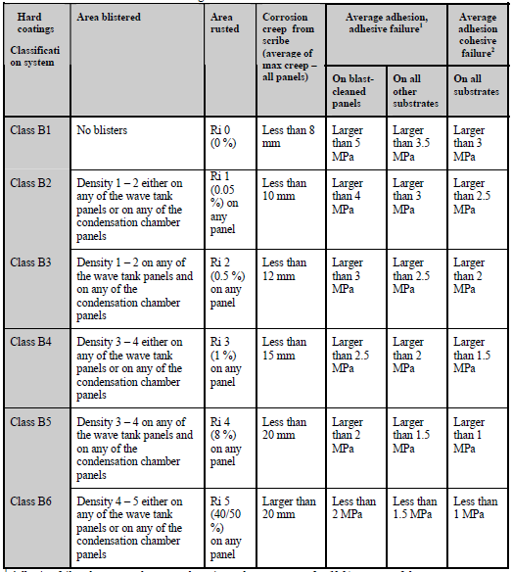
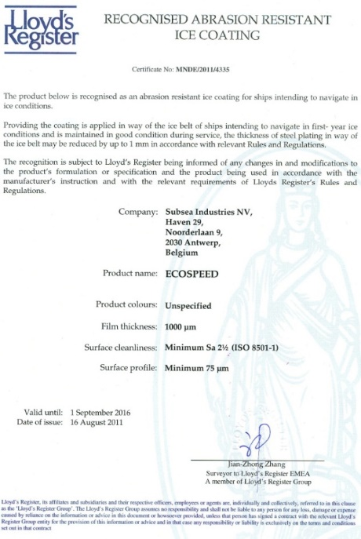
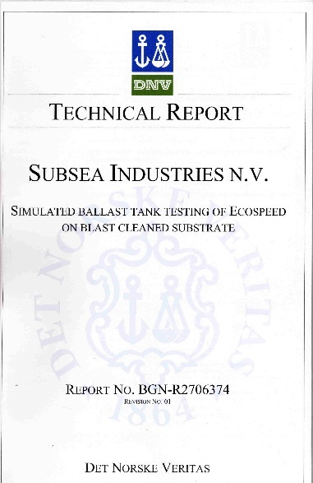
Proven performance
Ecospeed meets requirements of NORSOK M-501, system 7
Ecospeed has been given class B1, where B1 is the superior grade
Ecospeed is recognized as abrasion resistant ice coating

Slide 16
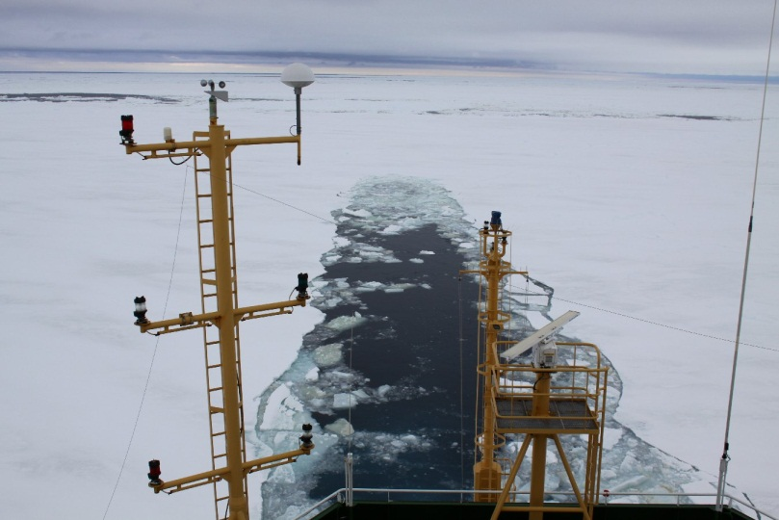
RRS Ernest Shackleton
RRS Ernest Shackleton
Ice class: DNV ICE-05

Slide 17
RRS Ernest Shackleton
Docking 2008 with ice coating
Docking 2009 with ice coating
Ecospeed application in 2009

Slide 18
RRS Ernest Shackleton
Stephen Lee: “Are you sure you’ve taken this ship in the ice?”
Docking 2011 with Ecospeed

Slide 19
RRS Ernest Shackleton
Condition of conventional ice coating after 1 year
Ecospeed after operating 2 winters in severe ice conditions
Docking 2011 with Ecospeed

Slide 20
RRS Ernest Shackleton
Application of ice belt and rudder in 2011

Slide 21
RRS Ernest Shackleton
Docking 2013 with Ecospeed

Slide 22
RRS Ernest Shackleton
“Ice coating” after 1 year
ECOSPEED® after 2 years
ECOSPEED® after 4 years

Slide 23
RRS Ernest Shackleton
ECOSPEED® after 7 years
Andrew Webb: “The hull on Shackleton is better than I’ve ever seen.”

Slide 24
RRS Sir David Attenborough
New build at Cammell Laird in Birkenhead

Slide 25
Repairing Ecospeed
Mechanical damages
Surface preparation
Restoring the coating

Slide 26
Typical parts where cavitation damage will occur
Rudders
Nozzles
Thrusters
Thruster tunnels

Slide 27
Cavitation damage

Slide 28
How to repair conventionally
Fillers
Welding
Re-design
Exchange rudder

Slide 29
How to repair on a permanent basis
Ecofix repairs
Ecoshield application
ECOFIX®: corrosion and pitting repair

Slide 30
Ecoshield: cavitation damage prevention
Blasting SA 2.5
Application first layer
Application second layer
Seatrade Awards winner 2014

Slide 31
Cavitation research
Cavitation durability research
Normally 6 stages
Ecoshield till stage 16 (!)

Slide 32
Ecoshield after 5 years
After 5 years with conventional coating
After 5 years with Ecoshield

Slide 33
Ecoshield after 7 years
After 7 years with Ecoshield
Grzegorz Girjat: “Since painting the rudder with Ecoshield we have had no more cavitation damage. We went on to coat all four sister ships due to the excellent performance.”
Application of Ecoshield

Slide 34
Questions?
This presentation including all images and videos © 2020, Subsea Industries NV, all rights reserved

